Slide 1





VEHICLE SERVICE
MANAGEMENT SYSTEM
A Modern Solution for Service Centers
GROUP LEADER
Souvik Ghosh (Roll No: 108250600263)
Snehasish Kundu
Sansuddhi Mukhopadhyay
Sneha Tiwari
Roll No: 108250600245
Roll No: 108250600210
Roll No: 108250600244
Under The Guidance of : Asst. Professor Bikram Saha
Institute Name : Asansol Engineering College

Slide 2




Introduction
A console-based application to streamline vehicle service operations. Replaces manual record-keeping with digital workflows.
Core Features
Vehicle Registration
Service History Tracking
Secure Authentication
Built with C for high performance and reliability.

Slide 3




Problem & Objective
The Problem
The Objective
Manual records are error-prone and easy to lose.
Build a lightweight, efficient tracking system.
Searching old history takes too much time.
Implement Role-Based Access (Admin/User).
No security restricts access to sensitive data.
Ensure permanent data storage without complex SQL.

Slide 4
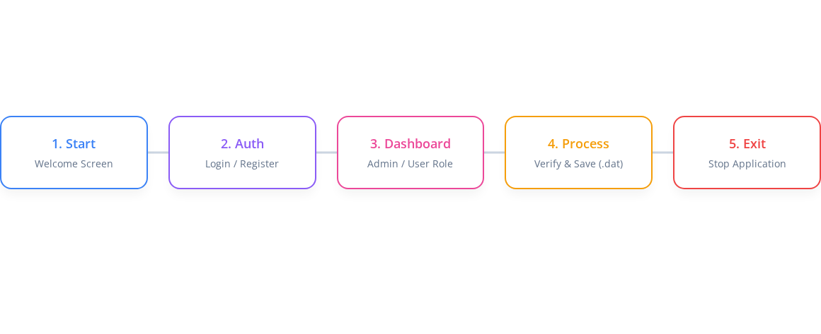
System Workflow
Digital workflow ensures data integrity at every step.

Slide 5




Requirements
Hardware (Minimalist)
Software
Processor: i3 or any modern CPU
OS: Windows 10/11
RAM: 4GB recommended
Terminal: PowerShell or Command Prompt
Storage: < 50MB disk space
Compiler: GCC (MinGW) for development

Slide 6








Tech Stack
Language
IDE
Compilers
Control
C (Standard C99)
Core Logic
Visual Studio Code
Development
GCC / Make tools
Build System
Git & GitHub
Versioning

Slide 7



Implementation
Modular Architecture
The code is organized into specific modules for better management:
Key Techniques:
Binary File I/O (fread/fwrite), Pointers for efficiency, Structs for data modeling.

Slide 8
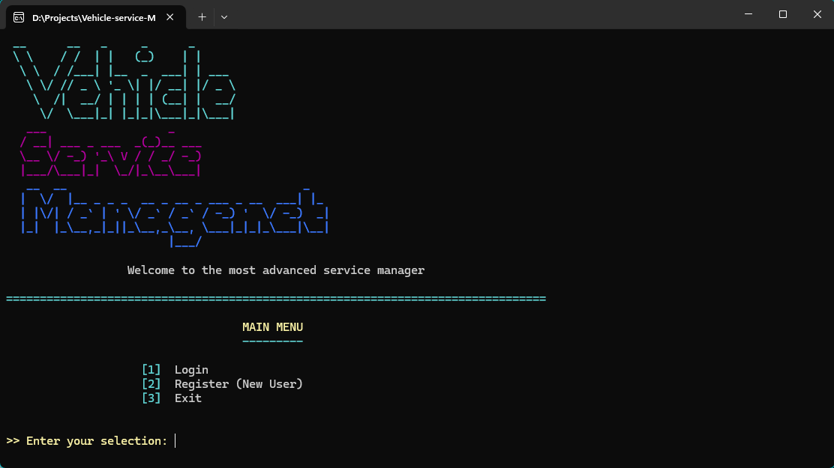

The Welcome Screen / Auth Interface
Insert Snapshot: Welcome Screen

Slide 9
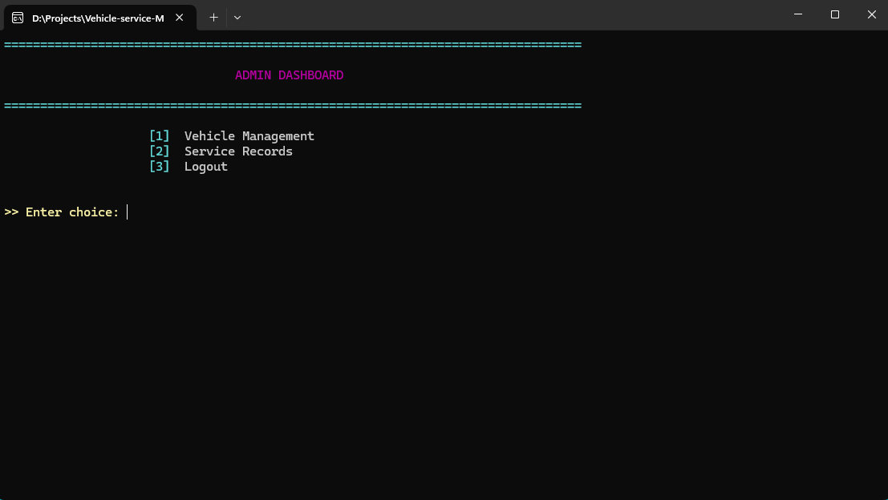

Admin Dashboard / Menu
Insert Snapshot: Admin Dashboard

Slide 10
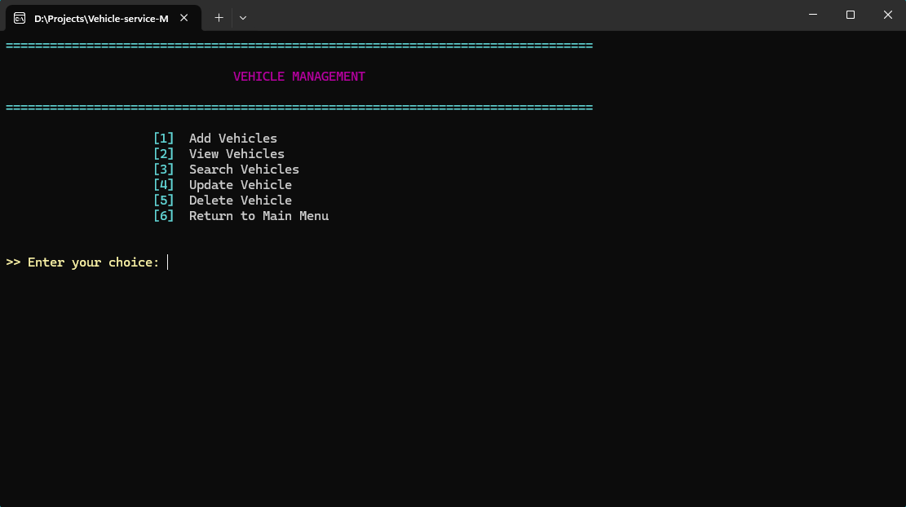

Vehicle Management Menu (Can only be accessed by
admin)
Insert Snapshot: Vehicle Management

Slide 11
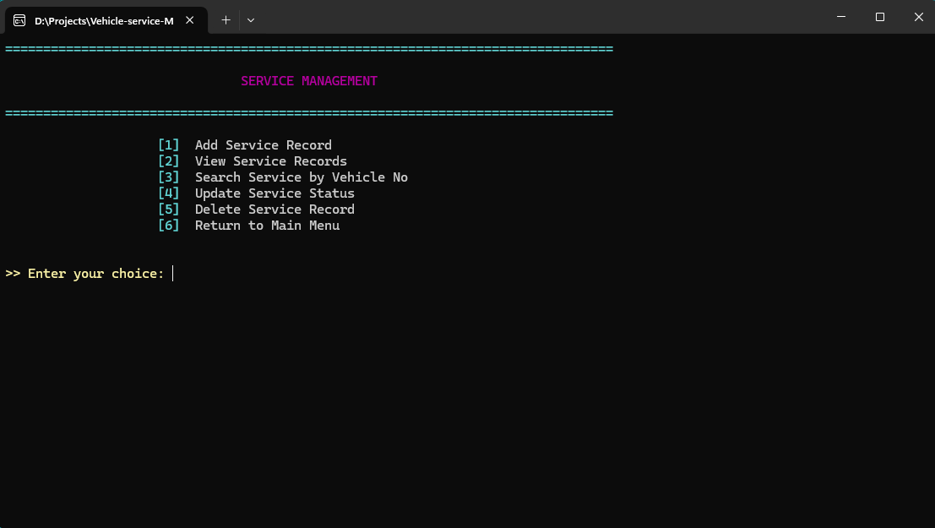

Service Management Menu (Can only be accessed by admin)
Insert Snapshot: Service Records Menu

Slide 12


User Dashboard / Menu
Insert Snapshot: User Dashboard

Slide 13
Results
Deployment & Management
User Experience & Data
Successful Deployment on Windows.
Instant Search functionality for finding vehicles.
Admin Can easily Add, update or delete Vehicles.
Professional CLI look with Green/Red status indicators.
Zero-Crash stability during file operations.
All data is saved permanently using file handling.

Slide 14
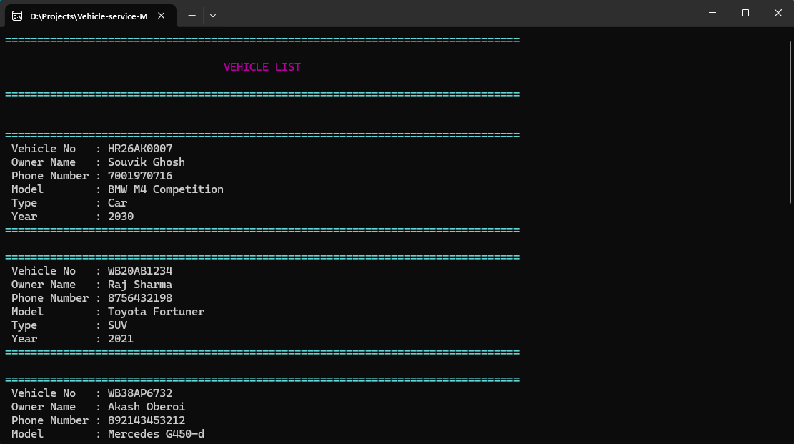

View Vehicles : Shows all vehicles list (Can only be accessed by admin)
Insert Snapshot: View Vehicles List

Slide 15
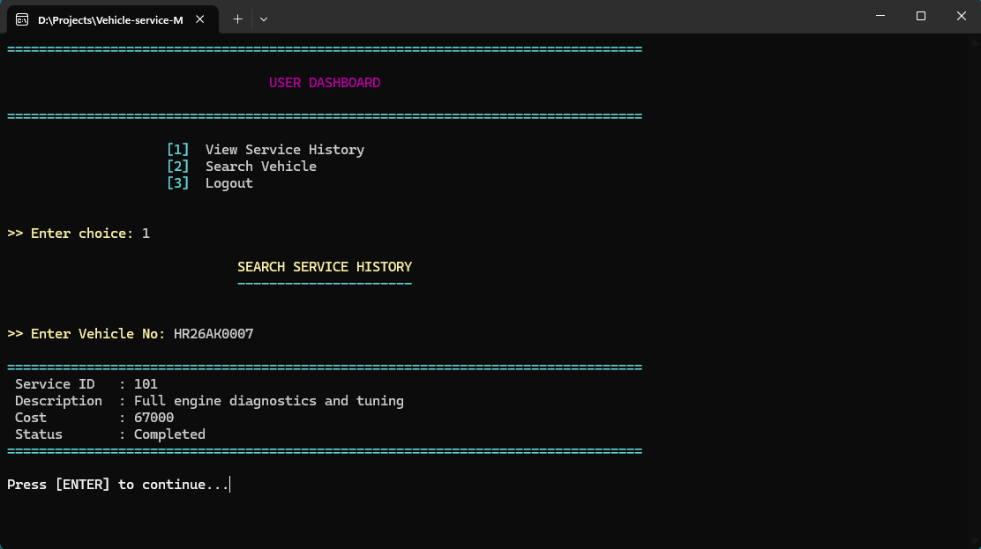

Service History: Shows Service History of Vehicle using Vehicle No. (For User)
Insert Snapshot: Service History

Slide 16
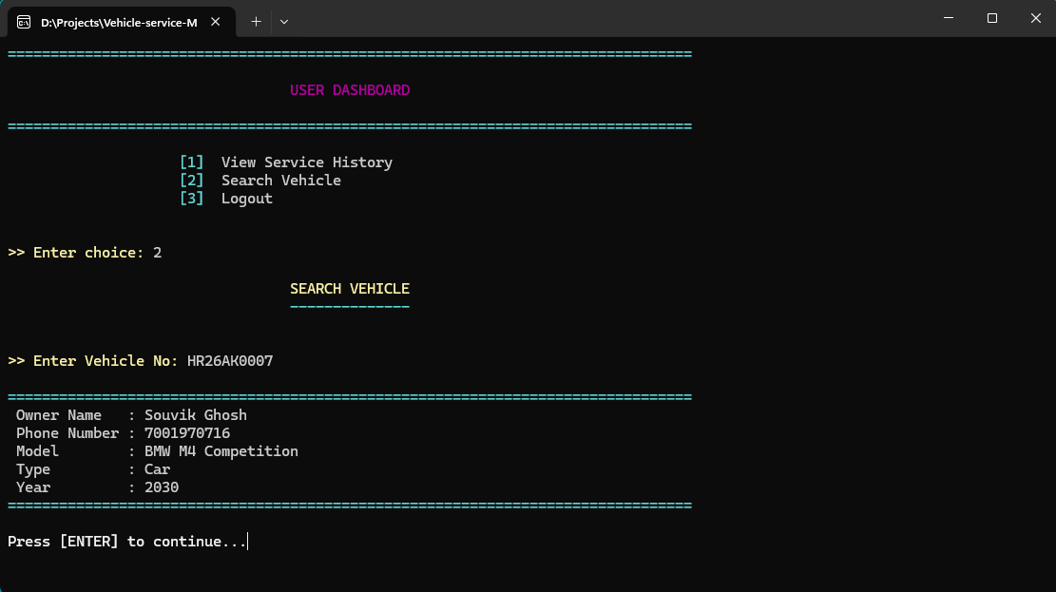

Search Vehicle : Shows the details of vehicle after taking Vehicle No.(For Both User and Admin)
Insert Snapshot: Search Vehicle Results

Slide 17
Analysis
Advantages
Disadvantages
Blazing Fast: No bloatware.
Keyboard Only: No mouse support.
Secure Data: Local binary storage.
No Online Sync: Local only.
Portable: Single .exe file.
Scaling Limits: File-system DB.

Slide 18








Future Enhancements
Graphical User Interface (GUI)
Database Upgrade
Billing Module
Networking
Generate PDF Invoices automatically.
Allow multiple computers to access the same DB.
Migrate to Qt framework for mouse support.
Move from .dat to SQLite/MySQL.

Slide 19



Conclusion
"The Vehicle Service Management System provides an efficient solution for managing vehicle service records. It replaces the traditional manual system with a computerized and structured approach."
Reduces Errors
Saves Time
Improves Productivity

Slide 20



THANK YOU
Any Questions?
Source Code on GitHub

Slide 21


Image Sources
https://static.vecteezy.com/system/resources/previews/021/488/896/non_2x/automobile-mechanic-man-working-illustration-vector.jpg
Source: www.vecteezy.com
https://img.freepik.com/premium-vector/software-developer-work-with-program-code-programmer-monitors-with-abstract-computer-language-script-backend-development-concept-flat-vector-illustration-coder-isolated-white-background_198278-16981.jpg
Source: www.freepik.com

